Slide 1
Regression Models
COMP6246: Machine Learning Technologies (MSc)
Dr Indu Bodala (i.p.bodala@soton.ac.uk)
02 October 2025

Slide 2
Lecture Outline
By the end of this lecture, you will be able to
  Understand how Linear Regression works
  Use Gradient Descent and its variations to minimize cost function
  Use learning curves to identify overfitting and underfitting in regression models
  Understand various regularization techniques

Slide 3
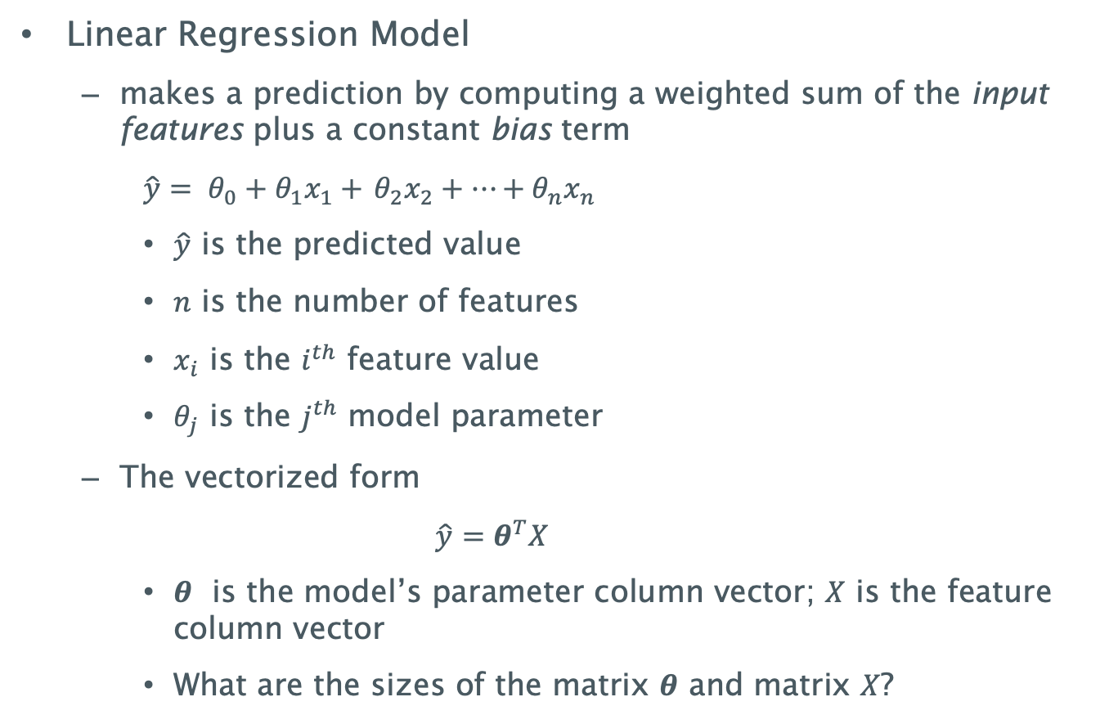
Linear Regression
Linear Regression Model
  makes a prediction by computing a weighted sum of the input features plus a constant bias term
    $\hat{y}= θ_{0}+θ_{1}x_{1}+$ $θ_{2}x_{2}+…+θ_{n}x_{n}$
    $\hat{y}$ is the predicted value
    $n$ is the number of features
    $x_{i}$ is the $i^{th}$ feature value
    $θ_{j}$ is the $j^{th}$ model parameter
  The vectorized form
    $$\hat{y}=θ^{T}X$$
    $θ$ is the model’s parameter column vector; $X$ is the feature column vector
    What are the sizes of the matrix 𝜽 and matrix 𝑋?

Slide 4
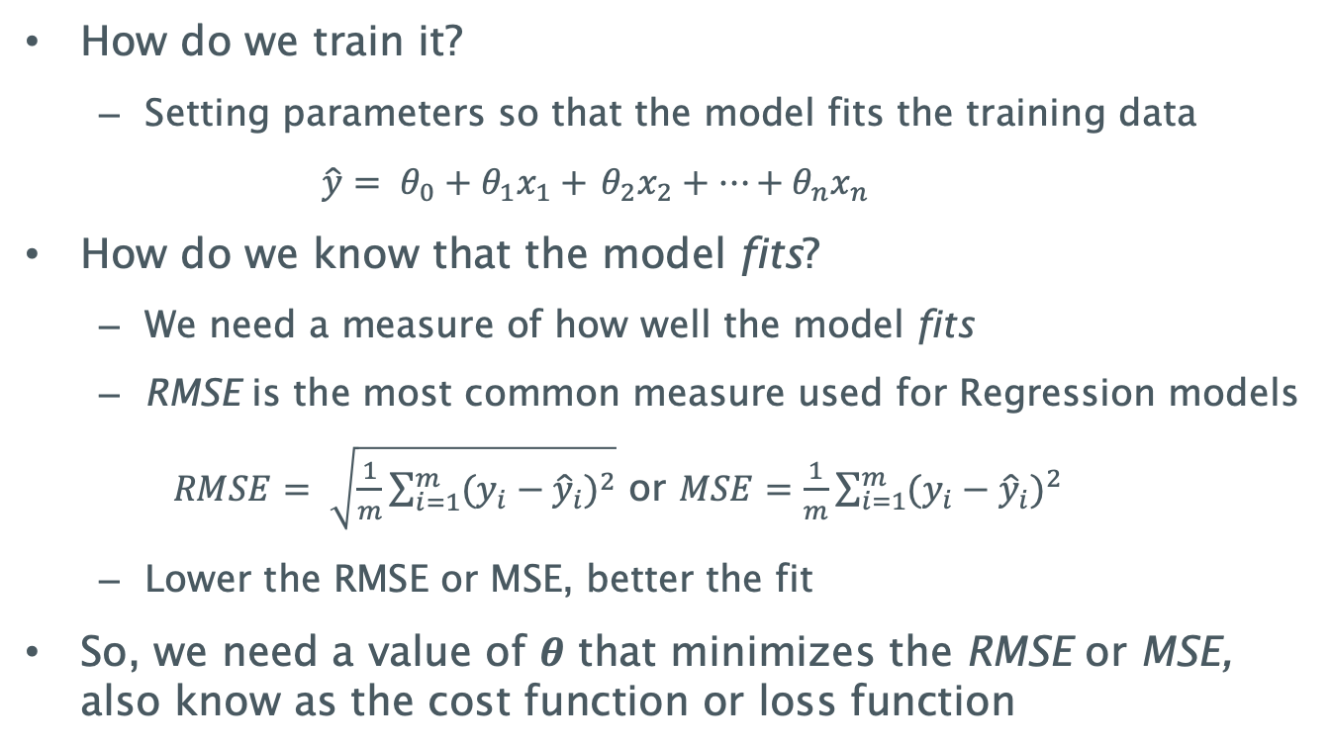
Training the model
How do we train it?
  Setting parameters so that the model fits the training data
  $\hat{y}= θ_{0}+θ_{1}x_{1}+$ $θ_{2}x_{2}+…+θ_{n}x_{n}$
How do we know that the model fits?
  We need a measure of how well the model fits
  RMSE is the most common measure used for Regression models
    $RMSE= \sqrt{\frac{1}{m}\sum_{i=1}^{m}{{(y_{i}−{\hat{y}}_{i})}^{2}}}$ or $MSE=\frac{1}{m}\sum_{i=1}^{m}{{(y_{i}−{\hat{y}}_{i})}^{2}}$
  Lower the RMSE or MSE, better the fit
So, we need a value of $θ$ that minimizes the RMSE or MSE, also know as the cost function or loss function

Slide 5
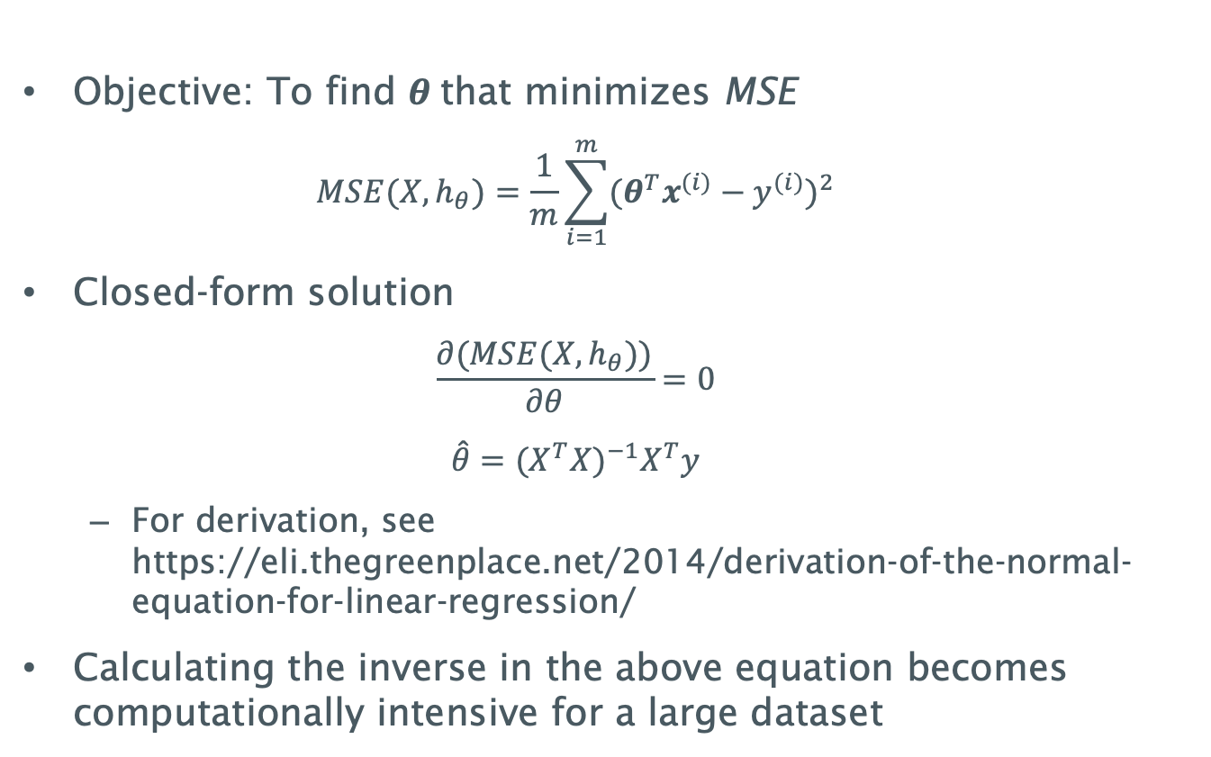
Closed-form solution
Objective: To find $θ$that minimizes MSE
  $$MSE(X,h_{θ})=\frac{1}{m}\sum_{i=1}^{m}{{({θ^{T}x}^{(i)}−y^{(i)})}^{2}}$$
Closed-form solution
  $$\frac{∂(MSE(X,h_{θ}))}{∂θ}=0$$
  $$\hat{θ}={(X^{T}X)}^{−1}X^{T}y$$
  For derivation, see https://eli.thegreenplace.net/2014/derivation-of-the-normal-equation-for-linear-regression/
Calculating the inverse in the above equation becomes computationally intensive for a large dataset

Slide 6
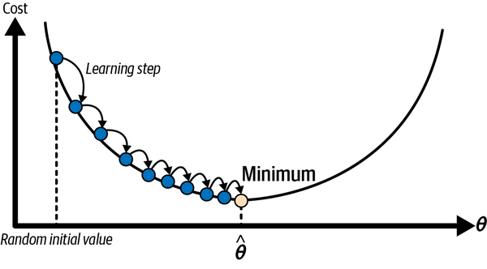

Gradient Descent Optimization
Gradient Descent is an optimisation algorithm
General idea is to tweak the parameters iteratively to minimize a cost function
  Start with a random initial value
  Compute the slope at that value
Why this curve for $θ$ ?
Negative
Increase θ
Positive
Decrease θ
Repeat until the algorithm converges to a minimum

Slide 7
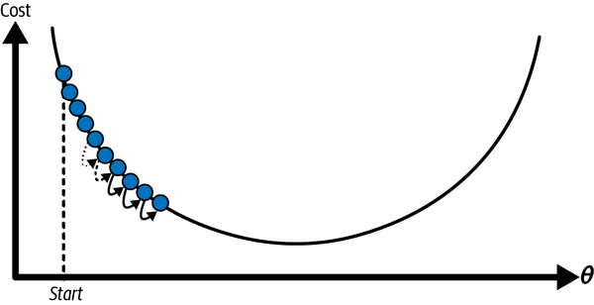
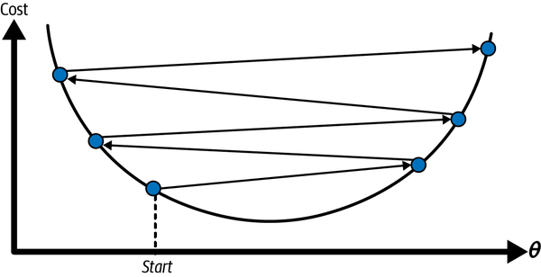
Gradient Descent – Learning Rate
An important parameter is the step size or the learning rate that determines how much to change θ
If the learning rate is too small, the algorithm takes a long time to converge
If the learning rate is too high, the algorithm may not converge

Slide 8
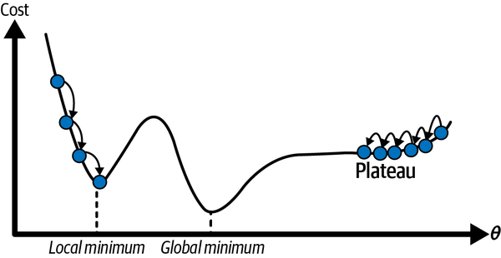
Gradient Descent – Local vs Global minimum
MSE for linear regression is a convex function → no local minima, just one global minima
Cost functions can have irregular shapes
Can converge to local minimum instead of global minimum, depending on the initialization
Initialisation on the plateau means the training takes longer

Slide 9
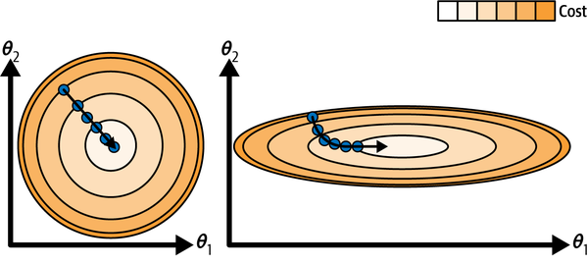
Gradient Descent – Feature scaling
Shape of the cost function can be elongated if the features are of different scales
Without feature scaling, algorithm takes longer to converge
Gradient descent with (left) and without (right) feature scaling

Slide 10
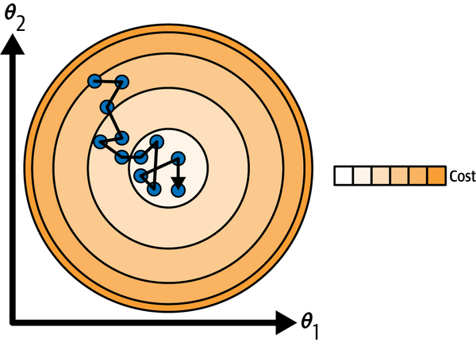
Batch vs Stochastic Gradient Descent
Batch (Full) Gradient Descent uses the entire dataset at each learning step. This can still take a long time if the dataset is too large
On the other extreme, we have Stochastic Gradient Descent
Uses only a single (random) data instance at each step and computes the gradient based on it
Faster but stochastic (random) in nature → causes the cost function to fluctuate; but decreasing over time
Can actually help the algorithm jump out of local minima
Randomness means algorithm cannot settle at the global minimum
  Simulated annealing – gradually decrease the learning rate

Slide 11
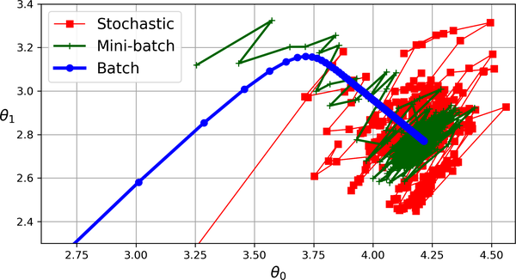
Mini-Batch Gradient Descent
Mini-batch GD computes the gradients on small random sets of data – mini-batches
Progresses less erratically compared to Stochastic GD

Slide 12
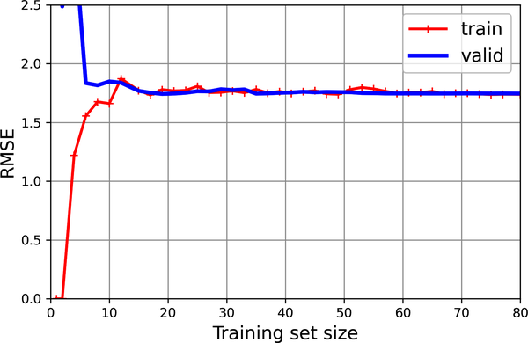
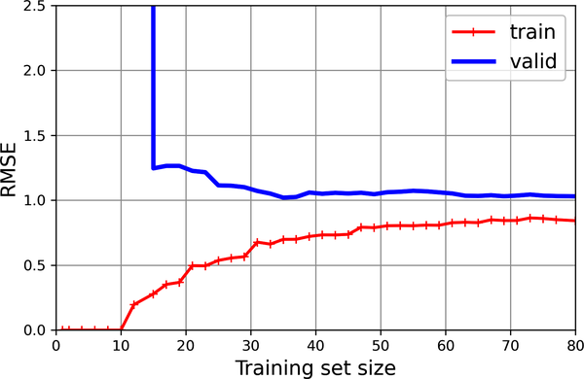
Learning Curves
Cross-validation can be used during training to evaluate how the model is generalizing
You can evaluate the model at regular intervals during training on both the training and the validation set
Learning curves plot training errors and/or validation errors as a function of the iteration or the training set sizes
Training Set
Training Set
Validation
set
Underfitting model
Overfitting model

Slide 13
Bias/Variance Tradeoff
Generalization error can be expressed as a sum of 3 different components
  Bias – Due to wrong assumptions. High-bias model is likely to underfit the data
  Variance – Due to the model’s sensitivity to small variations in the training data. Higher degree models are likely to have high variance and can lead to overfitting
  Irreducible error – Due to the noisiness of the data
Increasing model complexity → increases variance and reduces bias
Reducing model complexity → reduces variance and increases bias

Slide 14
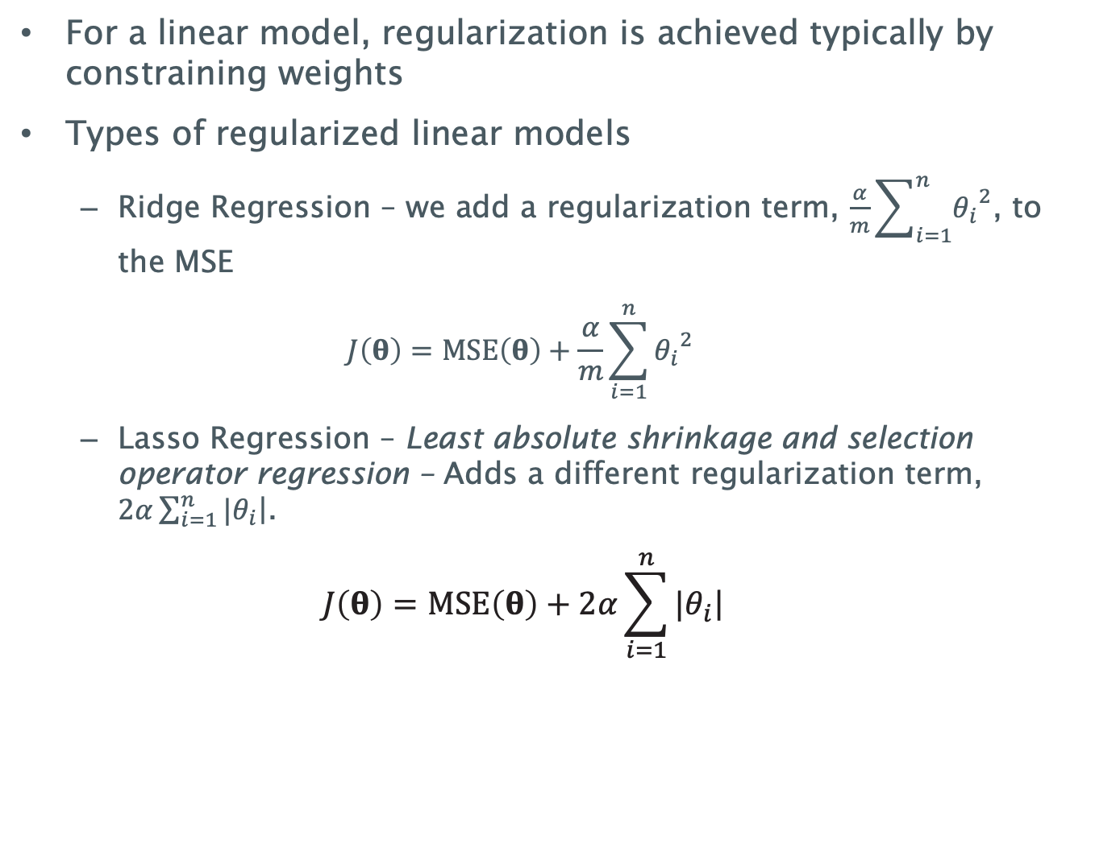
Regularization Techniques
For a linear model, regularization is achieved typically by constraining weights
Types of regularized linear models
  Ridge Regression – we add a regularization term, $\frac{α}{m}\sum_{i=1}^{n}{{θ_{i}}^{2}}$, to the MSE
  $$J\left(θ\right)=MSE\left(θ\right)+\frac{α}{m}\sum_{i=1}^{n}{{θ_{i}}^{2}}$$
  Lasso Regression – Least absolute shrinkage and selection operator regression – Adds a different regularization term, $2α\sum_{i=1}^{n}{|\left.θ_{i}\right|}$.
          $$J\left(θ\right)=MSE\left(θ\right)+2α\sum_{i=1}^{n}{|\left.θ_{i}\right|}$$

Slide 15
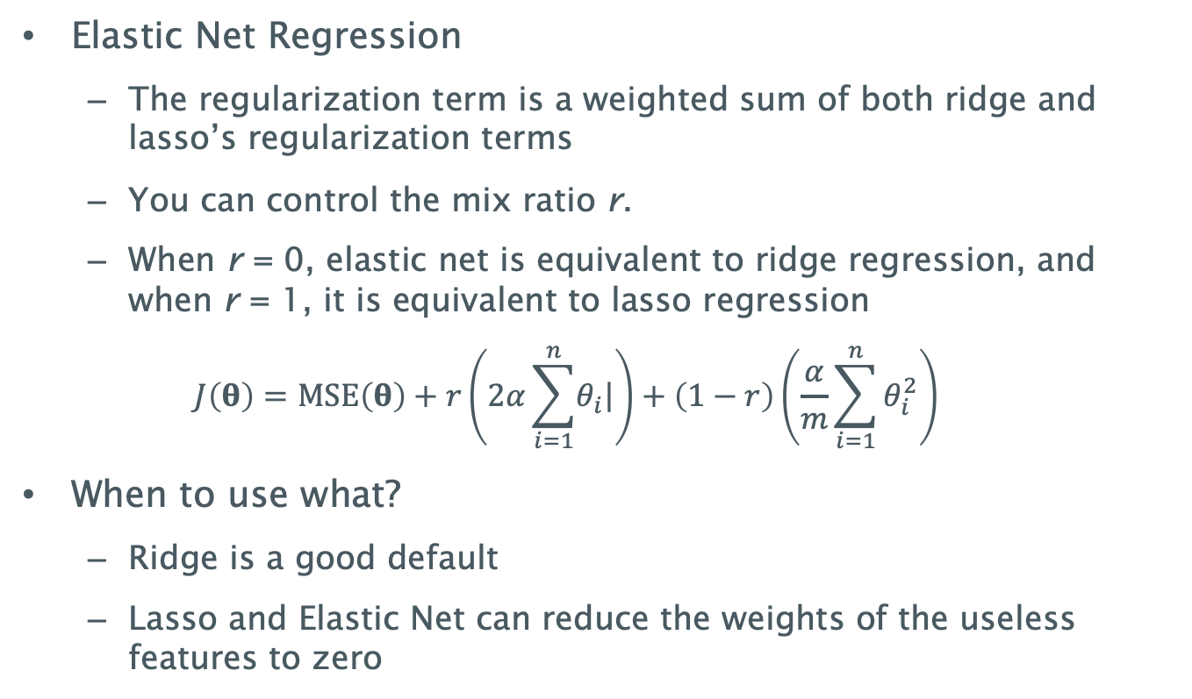
Regularization Techniques II
Elastic Net Regression
  The regularization term is a weighted sum of both ridge and lasso’s regularization terms
  You can control the mix ratio r.
  When r = 0, elastic net is equivalent to ridge regression, and when r = 1, it is equivalent to lasso regression
  $$J\left(θ\right)=MSE\left(θ\right)+r\left(2α\sum_{i=1}^{n}{\left.θ_{i}\right|}\right)+\left(1−r\right)\left(\frac{α}{m}\sum_{i=1}^{n}{θ_{i}^{2}}\right)$$
When to use what?
  Ridge is a good default
  Lasso and Elastic Net can reduce the weights of the useless features to zero

Slide 16
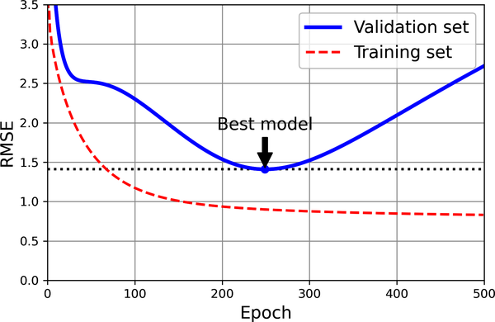
Regularization Techniques III
Early Stopping
  Another way to regularize is to stop training as soon as the validation error reaches a minimum
  Need to be careful when using stochastic or mini-batch GD

Slide 17
Summary
In this lecture, we looked at
  Linear Regression Model – definition and cost function
  Gradient Descent approach to minimize the cost function
  Variations to the Gradient Descent approach – Batch, Stochastic and Mini-Batch
  Using Learning curves to understand training and validation errors
  Bias/Variance Tradeoff
  Regularization Techniques – Ridge, Lasso, Elastic Net and Early Stopping
You will take a closer look at these techniques by implementing them during the labs.

Slide 18
Next Lecture: Classification Models
Questions?

